Slide 1
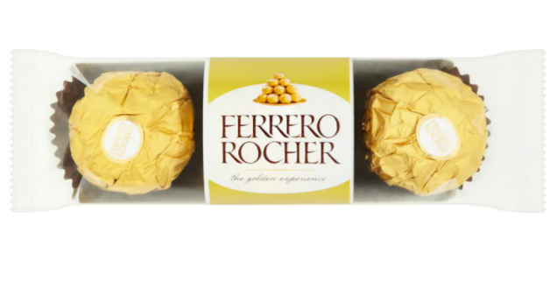
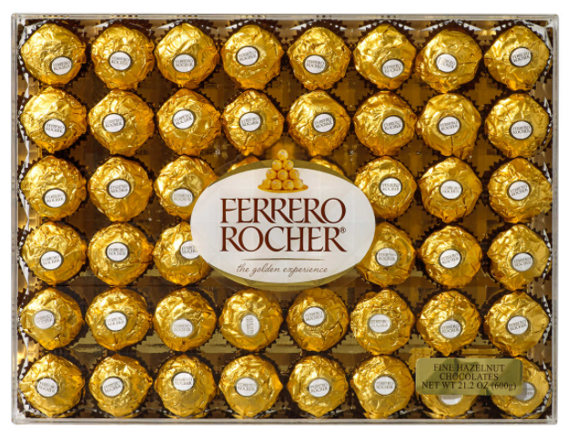
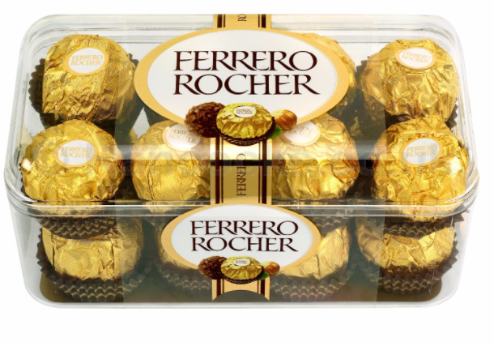
Arrays
Week 9
Sumaiyah Zahid

Slide 2
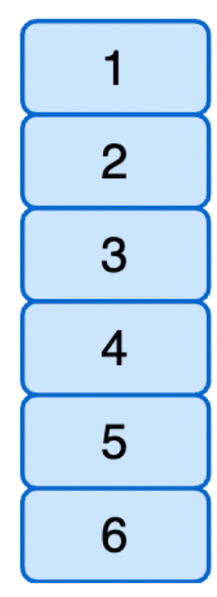
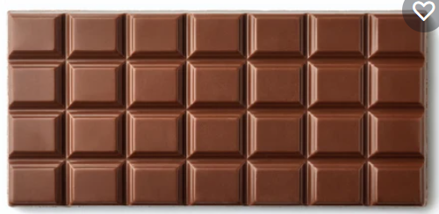
Array Definition
Consecutive memory location with same name and type just like consecutive bars of chocolates with same taste and size.

Slide 3
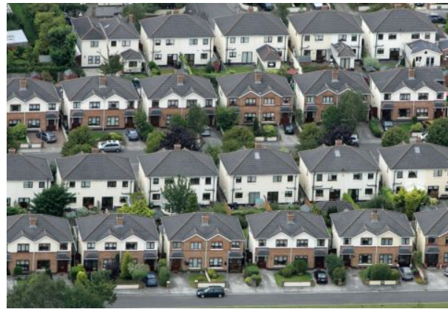
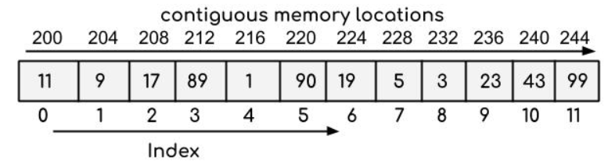
Array Definition
We have houses lanes for 80 yds, 120 yds, 240 yds etc.
Similarly we have int array , char array, float array etc.
e.g int array->

Slide 4
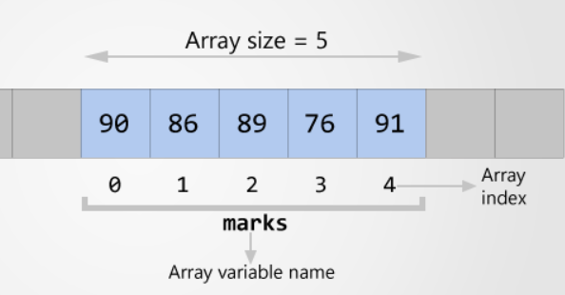
Declaration
Datatype ArrayName [NumberOfElements];
int marks[5]; // Declaration
int marks[5]={90,86,89,76,91}; //Declaration & initialization
int marks[]={90,86,89,76,91};
printf(“%d”, marks[2]);

Slide 5
Accessing Array Element
Make a c program to add all the marks into another variable sum and display the output.

Slide 6
#include <stdio.h>
int main()
{
int marks[5]={90,86,89,76,91},i,sum=0;
for(i=0; i<5; i++)
{
sum=sum + marks[i];
}
printf("%d", sum);
return 0;
}
}

Slide 7
Accessing Array Element
Make a c program to declare an array of size 5 and then take user input to initialize that array.

Slide 8
#include <stdio.h>
int main()
{
int marks[5],i;
for(i=0; i<5; i++)
{
printf("Enter number at %d location ", i);
scanf("%d",&marks[i]);
}
return 0;
}

Slide 9
Linear Search an Array
Make a c program to find the highest marks and display the output.

Slide 10
#include <stdio.h>
int main()
{
int marks[5]={90,86,89,76,91},i,high=0;
for(i=0; i<5; i++)
{
if(marks[i] > high )
{
high=marks[i];
}
}
printf("%d", high);
return 0;
}
}

Slide 11
Home Assignment
Make a c program to find the lowest marks and display the output.

Slide 12
Linear Search an Array
Make a c program to find the marks=86 and display the index of array where it exist.

Slide 13
#include <stdio.h>
int main()
{
int marks[5]={90,86,89,76,91},i;
for(i=0; i<5; i++)
{
if(marks[i] == 86 )
{
break;
}
}
printf("%d", i);
return 0;
}

Slide 14
CHAR Array
char name[30]="FAST NUCES"; //10 characters
int i;
for(i=0; i<10; i++)
{
printf("%c",name[i]); // FAST NUCES will print
}
printf("%s",name); // FAST NUCES will print

Slide 15
Please watch this video before coming to next lecture
https://www.youtube.com/watch?v=9I2oOAr2okY

